Slide 1
Name Artist & Title
Game 0001

Slide 2
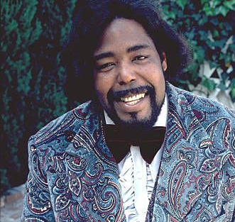
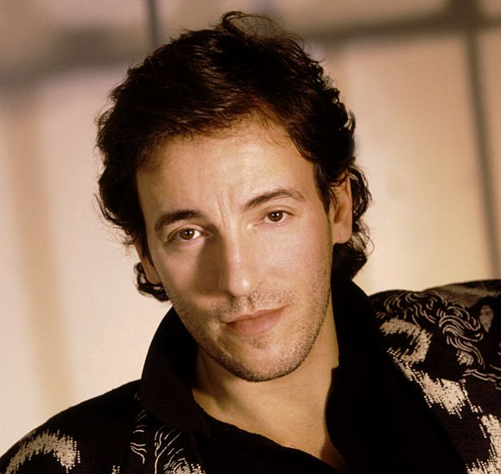
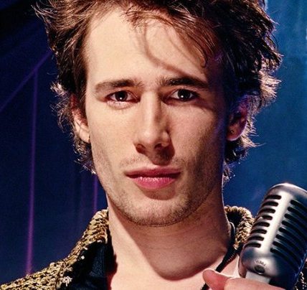
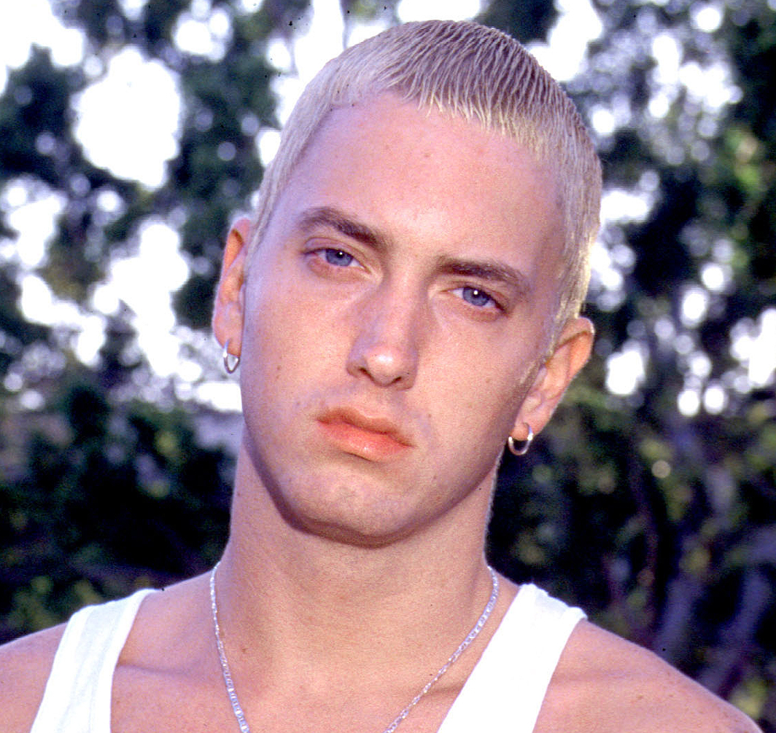
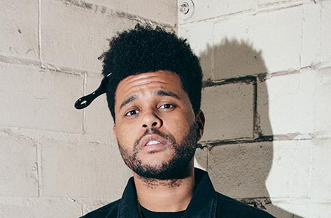
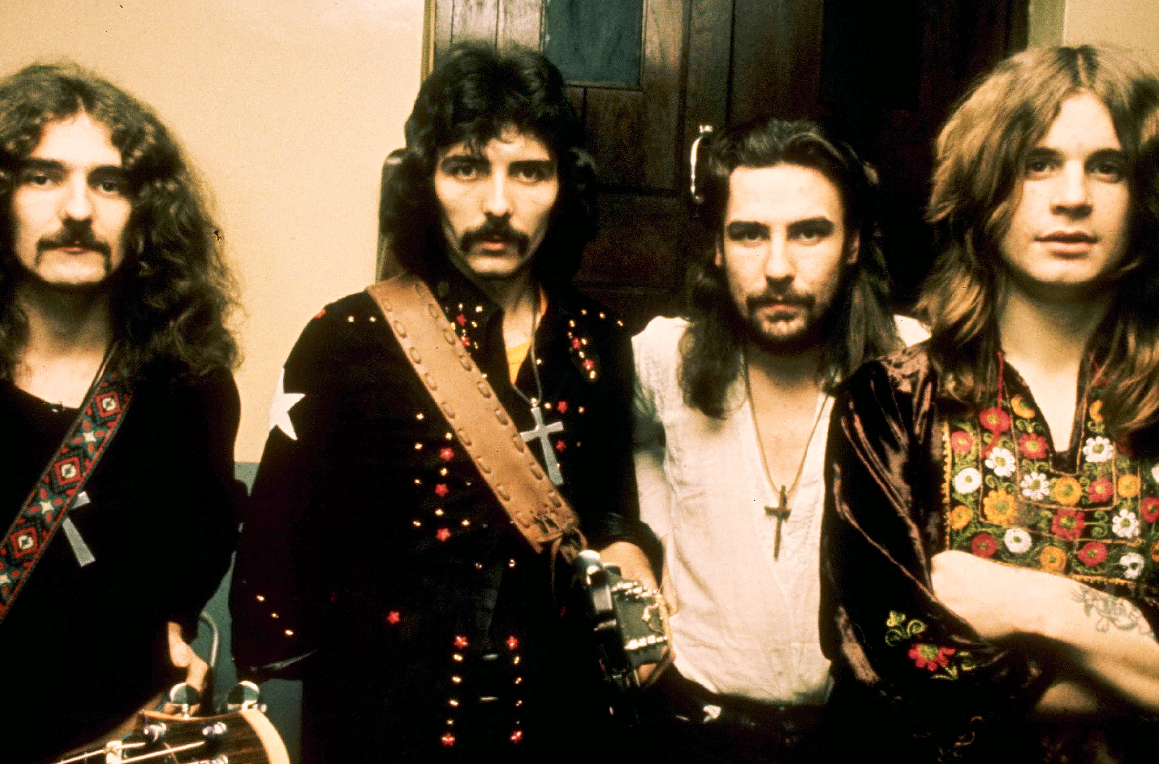
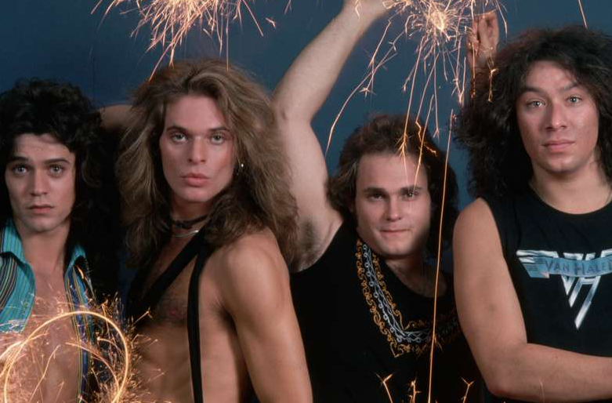
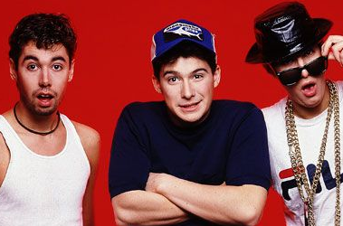
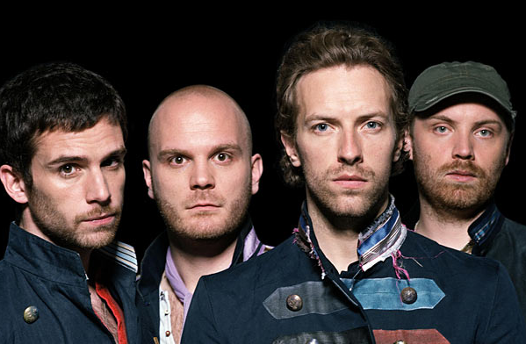
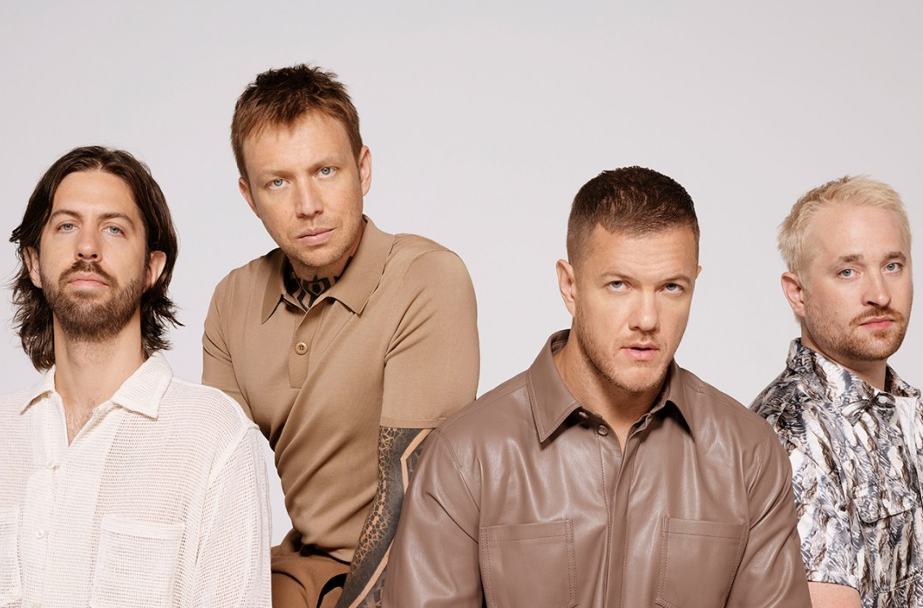
Picture Round
Instructions: Identify the artist or group on the line under each image

Slide 3
Decades In what decade was this version of the song originally released?

Slide 4
General Knowledge
Which member of The Monkees sang lead on “I’m A Believer” – a 1966 Neil Diamond written song that Smash Mouth made famous again when they covered it in 2001? Micky Dolenz
Who recorded the guitar solo on Michael Jackson’s 1982 hit “Beat It” for free, even though his manager, family, and friends told him he was a fool not to insist on a cut of the profits? Eddie van Halen
Complete this lyric from a 1994 song written by its author while on a short drive to Seattle: ”_____ _____ _____, won’t you come and wash away the rain?” Black Hole Sun (Chris Cornell from Soundgarden)
In what year did Taylor Swift’s win of MTV’s Best Female Video award prompt Kanye West to interrupt her onstage to say that Beyonce should have won? 2009
What British boy band was formed in 2010 after they solo auditioned for the X-Factor UK? One Direction
Widely used by jazz musicians for over a century, what type of book displays the melody, chord symbols, and lyrics of a song, but not its voicings or bass lines, leaving the interpretation and performance up to the artist? Fake book
Sung by Joey Scarbury, “Believe It or Not” was not only a #2 hit on Billboard’s Hot 100 in 1981 but also the theme song for what popular TV show? The Greatest American Hero
Usually either loved or hated by music aficionados everywhere, autotune (a production trick originally intended to mask off-key vocals) was first used on the song “Believe” by what artist in 1998? Cher
Collaborating with her future husband on the 2017 song “You Make It Feel Like Christmas” for her album of the same name, what singer married her reality TV show colleague in 2021? Gwen Stefani (Blake Shelton)
The first-ever original Disney song to land at Number One the UK’s Official Singles Chart, We Don’t Talk About Bruno is from what 2022 Disney movie? Encanto
According to Wikipedia in 2023, how many colleges or university schools of music are there in the United States? 236

Slide 6
Barry White
Bruce Springsteen
Jeff Buckley
Eminem
The Weeknd
Black Sabbath
Van Halen
Beastie Boys
Coldplay
Imagine Dragons

